Slide 1


1. Jerome Powell, Jackson Hole and John Taylor
The time has come for policy to adjust. The direction of travel is clear, and the timing and pace of rate cuts will depend on incoming data, the evolving outlook, and the balance of risks.
2. Why Yuan (CNY) is not the next big shoe after the Yen unwind?
Photo Credits: Shutterstock, FT
August 2024
Notes:
Good afternoon all, today’s macro update is split into two parts: the first being our key takeaways from Powell’s Jackson hole and how it translates into two sided risks and how informs our look on Fed rates in the year ahead and also what this means in terms of EM-Asia central banks potential to ease in Q4 .
The second update is to explain why some external commentary on the yuan carry being the next big thing to watch after the Yen carry unwind which we touch on last month is rather misguided.
First up, At Jackson hole., “the time has come” for rate cuts, this phrase in Fed Char Powell’s Jackson Hole speech marked the most distinct and unequivocal dovish shift for the Fed. Especially book-ended by pronouncements that “the direction of travel is clear”.
So, even if “timing and pace of rate cuts … depend on incoming data, the evolving outlook and the balance of risks”, it is arguably a much higher bar for inflation to even merely temper (much less throw off) rate cut plans.

Slide 2
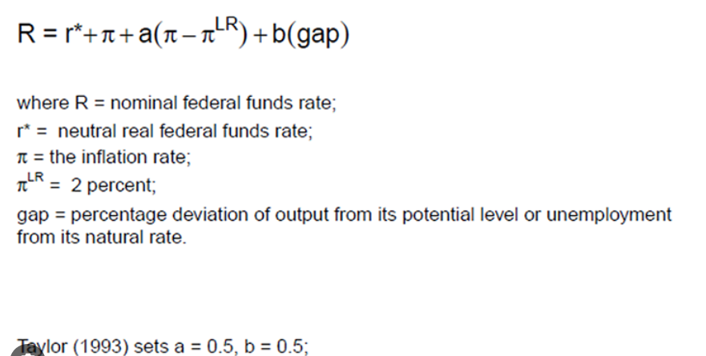
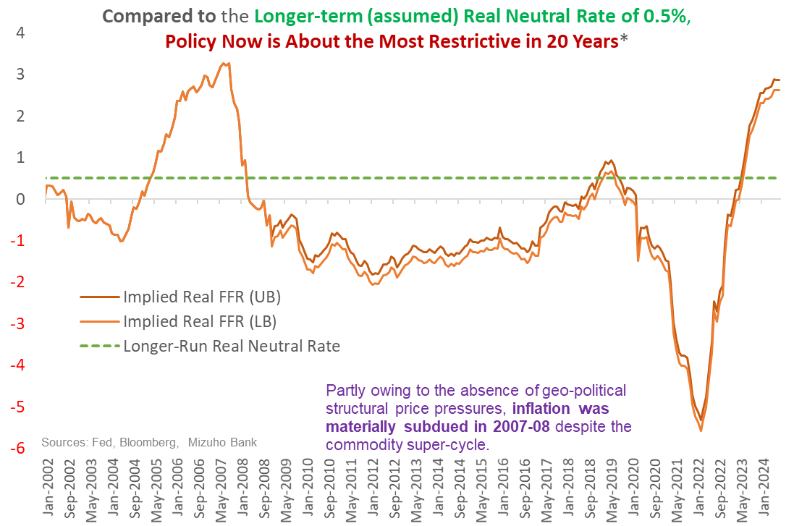
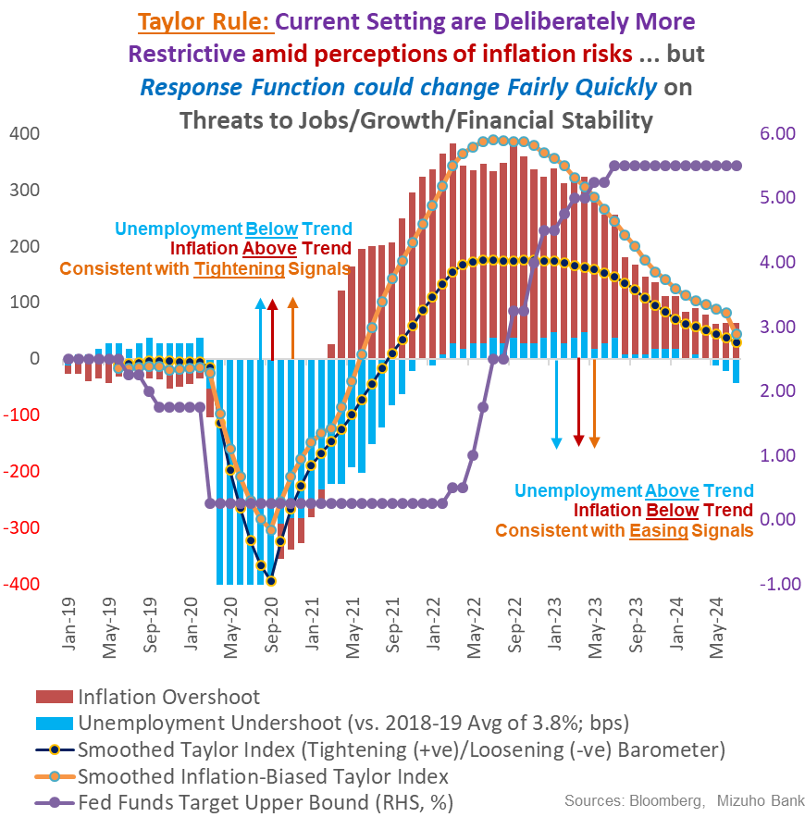
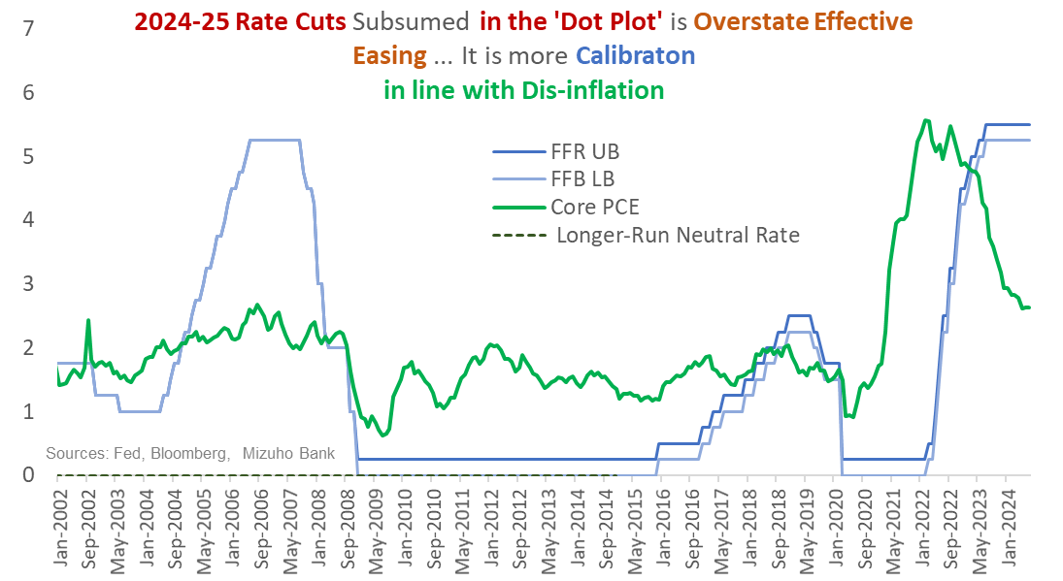
1a. Conditions are Exceptionally Tight – Taylor Rule Does Not Require Such Restriction
1.75%-2.25%
1.8%
3.7%
←2019
Notes:
First, we will start with explaining why we think that there is significant room to loosen even without a recession.
I will start with the Taylor Rule. First of all, the taylor rule is simply a mechanical rule that guides policy makers on what interest rate to set depending on how far inflation is from their target, that is the pie and pie long run respectively. And how far unemployment Is from its natural rate.
Let us turn this alien looking Greek equation into a simple scenario. Some time ago, I used to work with economic models, a lot of policy related numbers and get a lot of questions and today I will pose one of them today,
Imagine in 2019 when Fed fund rate was around 1.75% to 2.25% depending on which month you are looking at because the Fed was actually cutting rates.
and inflation in 2019 was averaging 1.8%, if inflation increase to 2.9%, and you are Fed chair Yellen at that time, what do you think the Fed policy rate should be? How much will you increase policy rate by to tackle 2.9% inflation? Should it be the above 5.0% rate ?
The current Fed funds rate has an upper bound is 5.50% and lower bound is 5.25%. That is at least a full 300bps higher than the 2019 rates even if I take the most conservative estimate.
Furthermore, unemployment rate in 2019 was averaging 3.7% in 2019 but now it is 4.3% which means rates should be lower.
This taylor rule thought experiment helps us get an objective view of interest rates, but we certainly acknowledge that decisions in life are subjective and based on past experiences
As such, it is should be evident that there is ample policy space to lower policy rates.
Even if we take a look at rate in inflation adjusted terms in terms of real rates, real rates are extremely high.
Next we also want to take the chance to point out that the rate cuts in the Fed’s june dot plot is really just calibration which inline with the dis-inflation rather than outright easing.

Slide 3
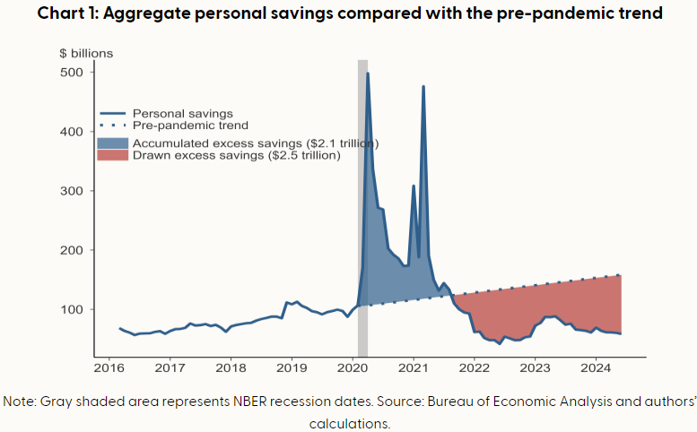
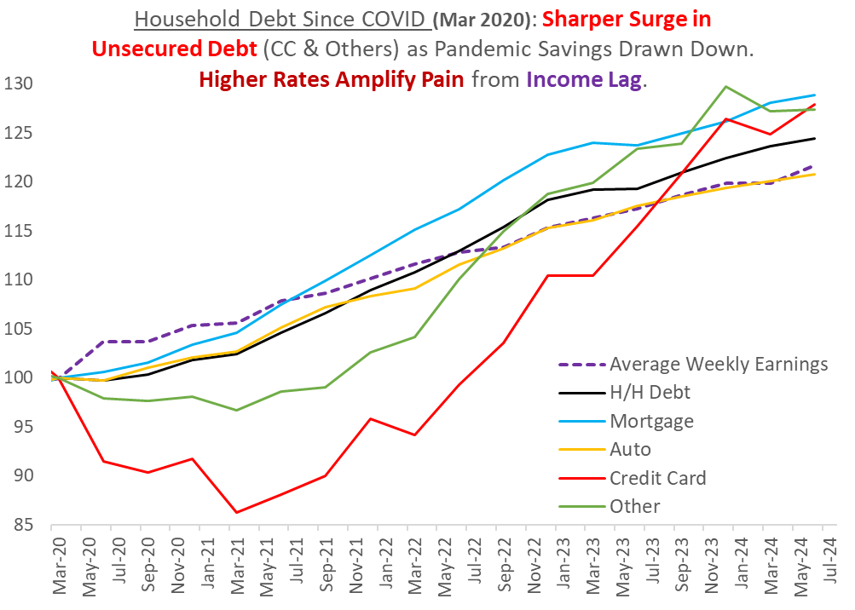
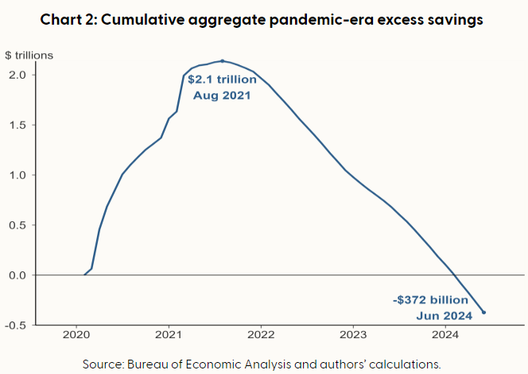
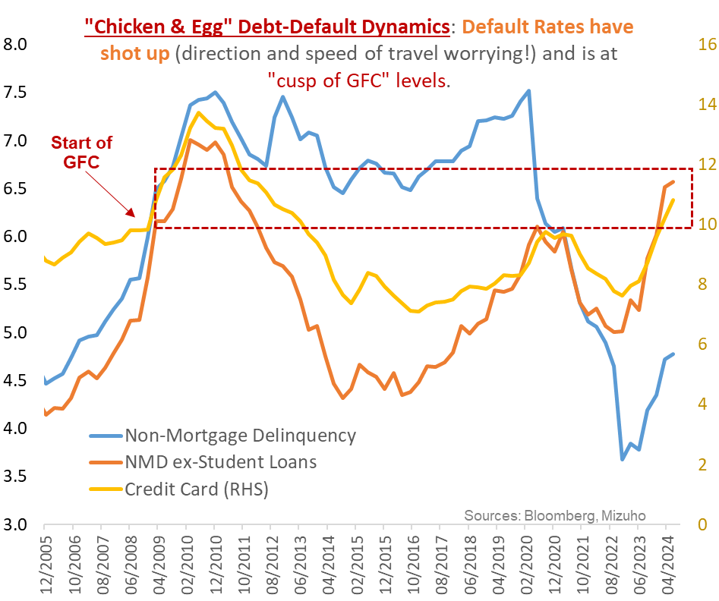
1b. Especially as Consumer Cash-flow Constraints Intensify, Threatening Demand Resilience
Chart from Bloomberg, San Francisco Fed,
Notes:
Furthermore, we see little need for the Fed to keep monetary policy so tight especially as consumer cash flow constraints start to intensify which threaten demand resilience.
As U.S. economic activity began to recover, households utilized their excess savings to support spending. By late 2021, household savings dipped below the pre-pandemic trend, signaling an overall drawdown of pandemic-related excess savings
We see that the updated data shows us that pandemic era savings has been eroded and this implies that households are digging into their pre-pandemic savings to the tune of 372bn.
In Powell’s words the pandemic distortions have healed.
Alongside the decline in savings, we also continue to observe continued growth in various forms of debt and most of these debt grow at a faster pace than income from employment.
Increase in debt at such high interest rate environment also mean that there is a higher debt servicing burden.
In particular, we see rising delinquencies in terms of credit card loans and non-mortgage delinquencies.
In our view, the speed of increase in the default rates look rather worrying and are at the cusp of pre-GFC levels.
To be clear, we are not advocating that there will be a recession in the baseline but we are against those who dismiss such a risk simply by saying that don’t worry we are not there yet. Here is the chicken and egg problem.
It is the GFC that caused the default rates to spike up, it is not the default rates that caused the GFC as everyone here is acutely aware of.

Slide 4
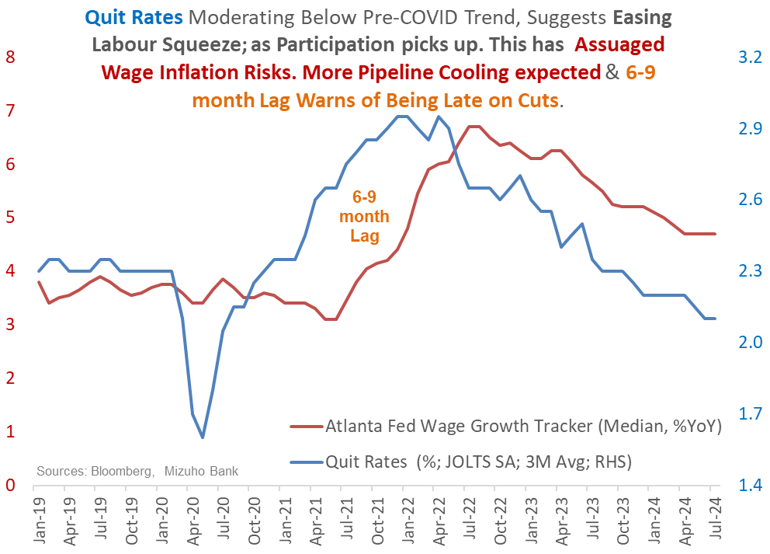
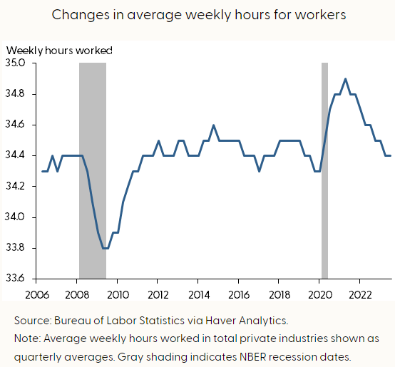
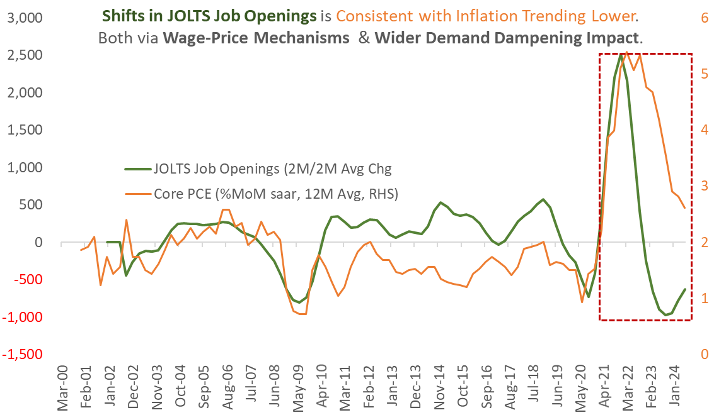
1c. Alongside Cooling Jobs/Wages, Type 2 Error May Abruptly Shift Fed Response
US Consumer - Tightening Cash-flows
Drawdown of savings, increased credit (and attendant servicing burden) and softening wage gains translate into tighter consumer cash-flows.
In turn the hit on demand will have negative multiplier effects at the margin, which significantly dampen growth outcomes; even if an outright recession is averted.
For a Fed that is decidedly not setting out to break something, this will be a jolt out of the Type 2 error resulting from the earlier Type-1 error.
“Type-1” Error: Wrongly rejecting null hypothesis of inflation risks.
“Type-2 Error: Wrongly failing to reject null hypothesis of persistent inflation risks
Notes:
In totality, the drawdown of savings, increased credit (and attendant servicing burden) and softening wage gains translate into tighter consumer cash-flows.
This will cause a hit on demand which will have negative multiplier effects at the margin, which significantly dampen growth outcomes; even if an outright recession is averted.
As for the labour markets which the Fed is concerned about, we updated the data such as quit rates which have continued to moderate to below pre-pandemic trend. Quit rates are a very important indicator of wage growth.
Afterall, when people quit a job and join a new one, they often get a bump up in pay. With a lower quit rate, there is less churn in the labour market which implies less pressure on wage growth. As such, we do think that underlying price pressures have room to soften as wage growth turns a little bit milder.
Furthermore the continuous decline in job opening also dampens risks of wage price prices.
Lastly, apart from US economic growth being strong being a reasons, I will give one other possible reason why the labour market have remain strong.
The reason is labour hoarding. Even as growth slowed in the US last year, there was no huge uptick in unemployment and workers kept their jobs.
More often than not, companies tend to hold onto workers even as demand falls, and we can see that from the bottom right chart. Initially because of the pandemic, there was difficulty in hiring but when firms hired more and activity slow, they will adjust for it by varying the hours worked rather than letting workers go. Now that the hours work has normalised into 2024, there is then the possibility of adjusting by letting workers go. In essence, the buffer from adjusting hours is no more and there is a stronger likelihood of adjusting by letting some workers go if growth softens a little.

Slide 5
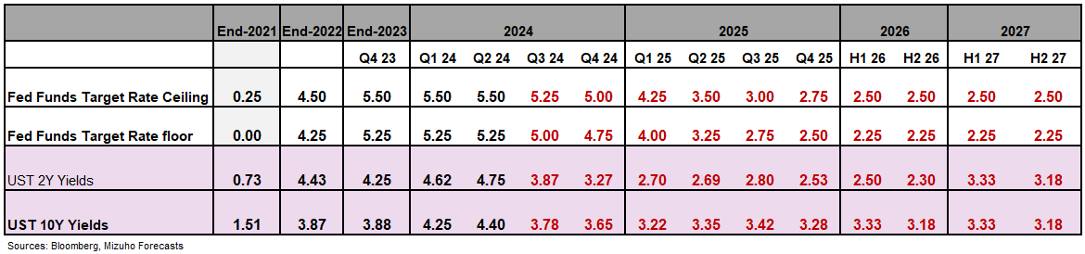
1d. Fed’s “Type-2” Error Risks – Flipping “Higher for Longer” to “Too High for too Long”
“Too High for Too Long” Risks Defer but Don’t Diminish Fed Rate Cuts
The quirks of post-pandemic durability in demand defer Fed rate cuts vis-à-vis past Fed cycles.
But ‘Type-2’ error (from overcompensating for “transitory”) of “too high, for too long” are accentuated now
Which accentuates the risks of having to catch-down more hurriedly with belated rate cuts.
“2024 Runway Curtailed, but 2-3 Cuts Likely …
Barring a crisis (not our base case), rate cut run-way for 2024 is constrained by data-watching and elections.
July FOMC virtually ruled out. September, November and December are “live”.
50-75 bps of rate cuts still on the table, with 50bp being most likely.
Rate Cuts to Gather Pace in H1 2025
Sharper demand softening alongside rapid slowdown set to diminish wage-price spiral risks.
Consequently, Fed rate cuts will gather pace in H1 2025 so as to alleviate acute policy restriction.
Up to 200bp of rate cuts by mid-2025 is not as outlandish. Fact is, 3.25-3.50% is likely still restrictive.
Consumer Slowdown, Not Crisis
Brisker cuts are premised on sharper consumption slowdown amid tightening cash-flows ➔ Not so soft landing
And not a crisis from a balance sheet shock – for which far deeper and larger rate slashing will be required.
Notes:
In turn, given the backdrop, our call (which is unchanged from May) for at least 8 cuts (totaling 200bp) by mid-2025 is beginning to look distinctly docile from being outlandish earlier. Our sense is that this will most likely be a 2-6 or a 3-5 split (between 2024 and H1 205) in terms of the timing of rate cuts between now and mid-2025. And to be sure, the risks are tilted to the Fed responding with more cuts, not fewer than what we have assumed. And with distinct risk of at least one upsized 50bp cut along the way. Probably more. This squares with our bias that the Fed is more likely to cut more, not less.
For the remainder of 2024, the runaway is a little more curtailed because of the need for data watching and elections. Afterall, We do have one more NFP print next week.
It is worth a gentle reminder that 3.25-3.5% in mid 2025 is still restrictive in real rate terms or even if we go back to my naïve example of janet yellen in 2019 which is that Janet yellen raising rates by 100bps to match the increase in inflation.
As such, it is worth another reminder that these cuts you see here are not of the crisis type of cuts. In fact. The risk here is that the Fed may be overcompensating for their earlier transitory inflation by keeping rates too high for too long.

Slide 6
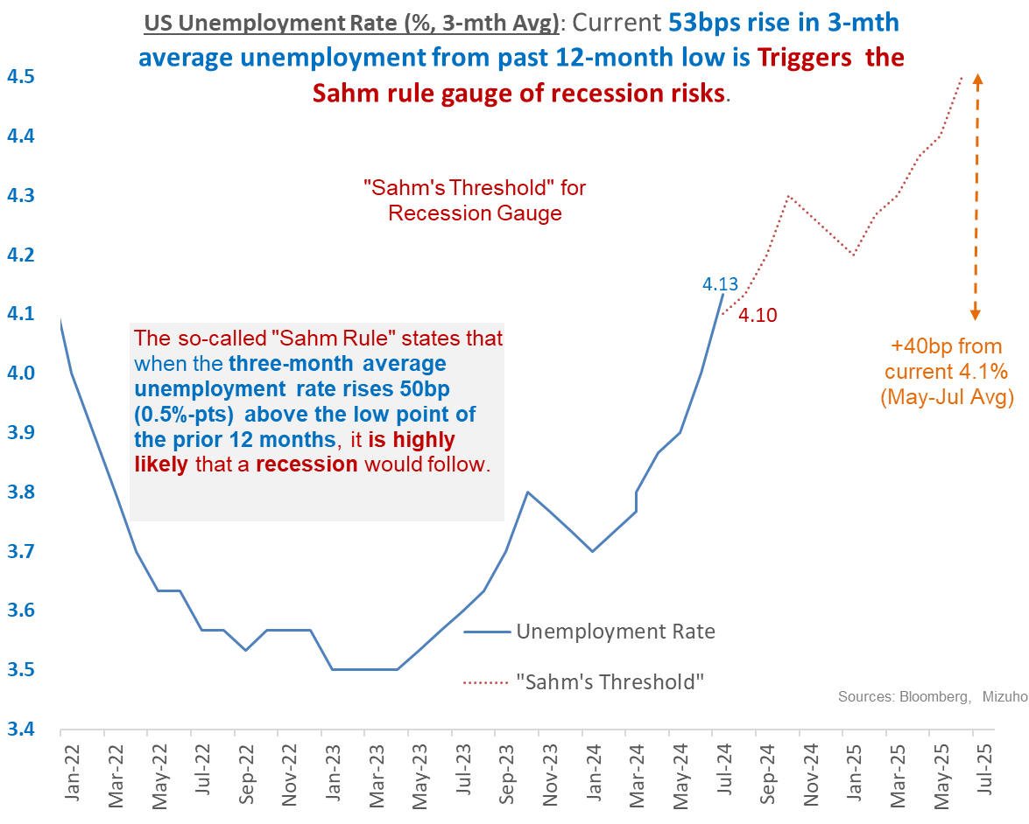
1e. US Economy: ‘Sahm’ Fears About Flawed Soft Landing Assumptions?
Type 1 Error: person may see the bear when there is none (raising a false alarm) where :
“There is no bear”.
Type 2 Error: A person may miss discovering the bear when in fact a bear is present (hence fails in raising the alarm)
US recession fears triggered suggests fragility of “Goldilocks” assumptions.
Fed “do(es) not seek or welcome further cooling in labor market conditions”
Notes:
On that note, we turn to the implications for markets, we do think that it is essential to flag out that there can be two main scenarios to rate cuts, the current one appears to be a risk on pivot premised on a soft landing scenario, the other one is a risk off recession risk pivot.
Even though US equities are now approaching record highs, let us not forget the post non-farm payrolls reaction we had at the start of this month when the SAHM rule was triggered,
I remember I had the good fortune of mentioning the Sahm rule at this meeting last month, which was one week before the fateful or some call fatal NFP print
That night, unemployment rate jumped, UST yields nose dived 20bps and US equities plummeted as recession fears were rampant.
After that, Fed officials calm markets down by saying that the increase in unemployment rate is due to increase in labour supply and it is good problem because if more people are looking for work, the increase in labour supply will cool wage pressures and inflation.
What we want to say here is that the soft landing assumption by markets is really still an assumption, if the increase in unemployment was really such a good problem, why would Fed Chair Powell sound such a strong note at Jackson that “ he does not welcome any further cooling in labour market conditions.
As such, the situation now depends on the Fed’s ability to navigate rate cuts in a manner that is able minimally maintain current growth conditions.

Slide 7
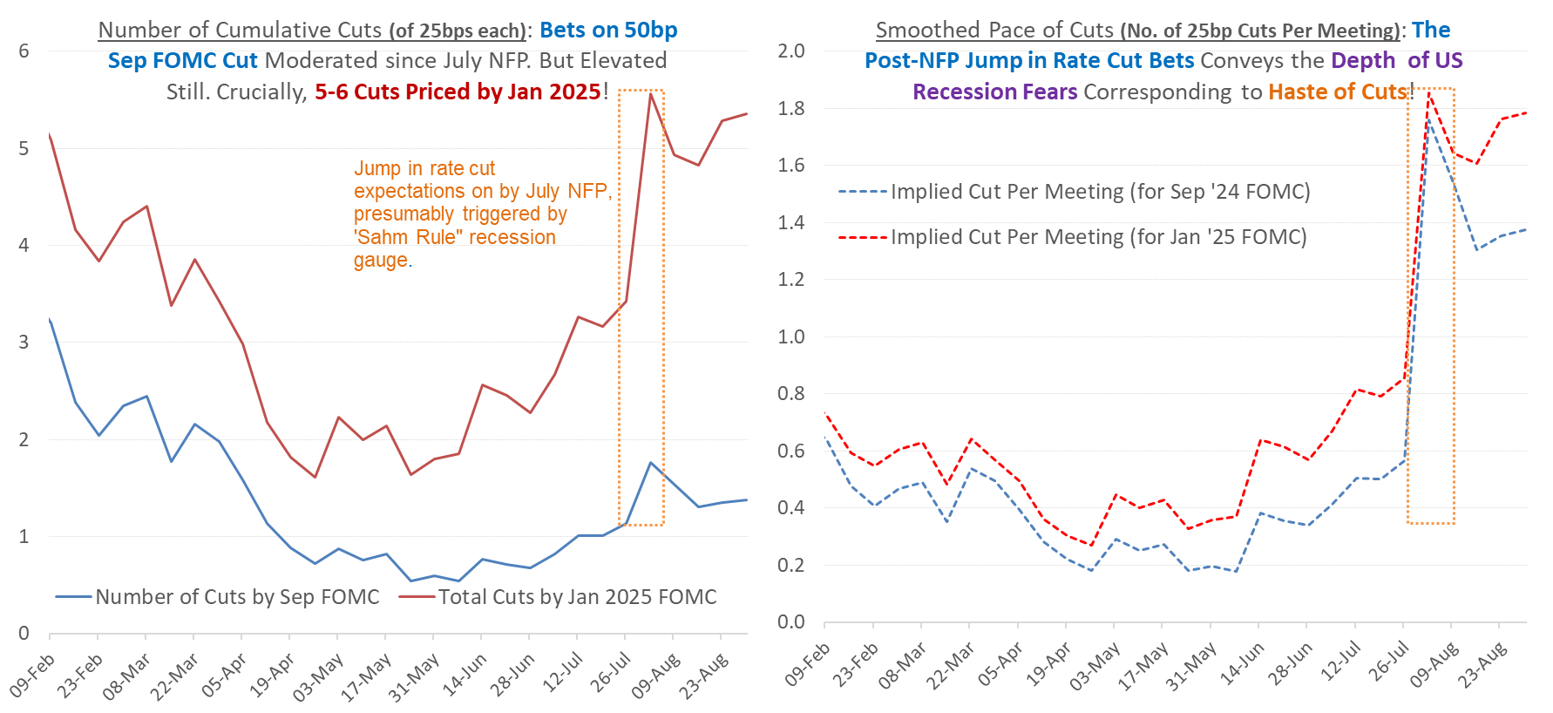
1f. Hyper Sensitivity to US Recession Risks & Fed Response
2015-19: 192k
July NFP:114k
Risk Off: Pressuring US equities even as UST yields fall and USD turns defiant even as yields soften
Notes:
There are two particular risks or rather threats to this unfettered “pivot risk on rally;
First, markets may be hyper-sensitive to incoming data such as the next NFP print, accentuating latent volatility in UST yields and USD. Fact is, beyond a “Goldilocks threshold” for US slowdown, RORO-type* of swinging price action in equities may be inadvertently triggered by US recession fears, related to worse case iterations of jobs deterioration.
At the NFP print earlier this month, we saw a spike in the probability of a 50bps cut to above 50% from less than 10%, these odds have moderated to around 30% chance of a 50bps cut at the September FOMC.
Crucially, markets are still pricing in 5-6 cuts by Jan 2025 which is also saying that one of the cuts needs to be an upsized one given that there are only 4 meetings.
This haste of cuts actually conveys the signal that markets in terms of rates are signaling recession Feds.
US recession fears dislocate “usual” “risk on” pivot dynamics”, instead pressuring equities rallies despite falling yields. USD too defiantly turns higher amid “risk off” and softer yields.
In terms of the NFP print next Friday, current market expectations are for it to improve to 160k in August from the low of 114k in July.
The challenging thought experiment here is to think of what type of payrolls report may affirm a 25bps cut and what number will bring us to confirm a 50 bps cut.
I would say that anything around 120k job gains or lower than July’s print will significantly raise the odds of a 50bps cut given that the Fed does not welcome any further weakening of the labour market.
Even if market expectations of 160k is met, it may not erase the current odds of a 30% chance of a 50bps cut especially considering that the 2015-19 average is 192k.
Meanwhile if the NFP print exceeds 200k, then very likely we will see that the odds of a 50bps cut drop and the Fed is likely to go for smaller cut.
Even as we do this thought experiment, let us not forget two other factors, the unemployment rate which can also change the view of the labour market and also because of the sheer room available to the Fed to ease which we have presented so far, the Fed can also chose to opt for an insurance cut, although the chance is low but not none, because this will need to be skillfully carefully communicated by Fed Chair Powell so that it is not interpreted as a sign of recession or deep underlying trouble.

Slide 8
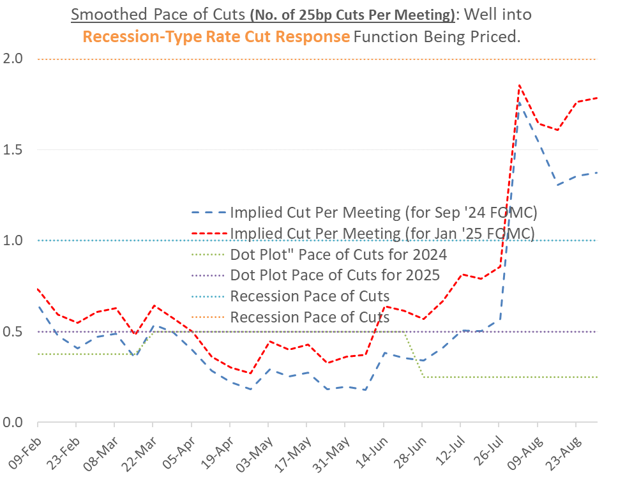
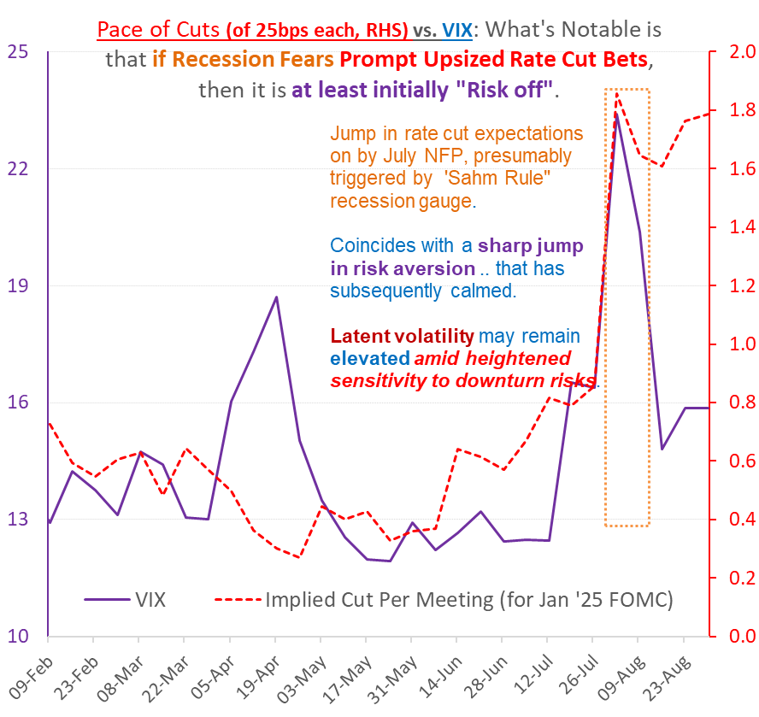
1g. US Jobs – Teetering on US Recession Fears & Attendant Risk Off
*RORO is short hand for describing highly volatile markets wildly swing between “risk on and risk off”.
Notes:
On that, we caution that there will be two-way volatility from fluid Fed cut expectations and noisy re-pricing playing off data, but crucially, there may be sudden “risk off” from recession risks that overwhelm “pivot risk on” from rate cut bets.
Hence, the pivot bet favourite for bulls conceals potential for being a cautionary tale of downside risks not fully priced into currently exuberant equities.
The VIX index has come down since the NFP print but latent volatility remain elevated amid the heightened sensitivity to downside risks.
On balance, volatility has been accentuated post Jackson Hole with the tendency for the RORO risk ro risk off phenomena given the ultra sensitivity to data even though it is more subdued related to the July NFP spike even as the USD has undeniably weakened in August. .

Slide 9
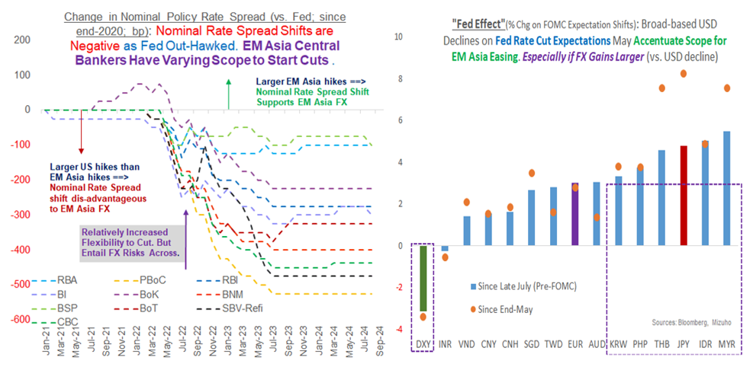
1h. Can EM-Asia Start Cutting Rates?
Rate Hold in August:
Bank of Thailand (dovish tones on credit quality)
Bank of Korea (hints of Q4 cut but property prices obstruct)
Bank Indonesia (open up possibility of Q4 cut)
Bank Negara Malaysia
Rate Cut in August:
BSP cut by 25 bps with the possibility of more easing in Q4
Notes:
For all of us in the region, the recent sharp and anticipatory drop in UST yields and USD, suggests scope for EM Asia central banks to start cutting as some of the pressure on regional currencies ease.
But only cautiously and tentatively as nascent rate cut plans must necessarily be responsive to any flux in market conditions and ready for any remedial interim suspension.
This month we saw the likes of the Bank of Thailand, Bank Indonesia and the BoK cautiously stayed on hold while the BSP’s rate cut two weeks ago was deftly executed, seizing on Fed rate cut expectations.
To be clear, the BSP’s cut did not solely hinge on Fed expectations shift. Instead, the BSP had the benefit of ample economic justification as well.
In Philippines private consumption contracted for 2 consecutive quarters and their nominal policy rates are elevated which imply that they have at least 150bps of cuts of room to cut if growth continues to weaken.
In their case, 25bps of cuts is really calibrated because I remember waking up to headlines of the BSP hiking rates of 75 bp and 50bps in off cycle moves so the current moves are really in the realm of being calibrated.
The BSP also signaled that there is possibility of more easing in Q4.
In Korea, the BoK kept rates on hold but has hinted at the possibility of Q4 cut and their inability to pinpoint at which meeting reflects their own constraints such as escalating property prices in Seoul and the authorities are cognizant not to fuel any property asset price bubble. Nonetheless, they epitomized the need to be responsive to market conditions and also nimble to their own conditions and not stick to a pre-defined path.
Meanwhile, in Indonesia, given the recent rupiah appreciation, Bank Indonesia also opened up the possibility of easing in Q4 but they signaled their caution by only assuming two fed cuts in 2024 which then implicity assumes two or less cuts for Bank Indonesia given that they may not front run and certainly not out cut the Fed.
The BNM remains at the opposite end of the spectrum given their neutral policy stance and that has aided the MYR outperformance in August.
As for Thailand, the BoT indeed held rates and characterized their policy also as neutral. but their warning on tightening financial conditions amid worsening credit quality among household and SME really strikes a dovish note in my view and as such the BoT has some potential to ease in 2025 but only one or two cuts given that their policy rates are only at 2.5%.
On balance, in our region, rate cut plans must be rather fluid rather than set in stone so that they are responsive to any flux in market conditions and ready for any remedial interim suspension

Slide 10
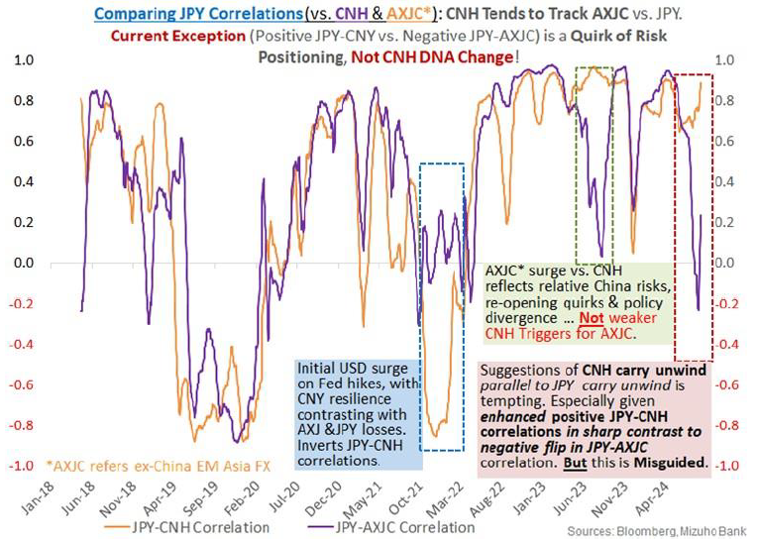
2. Misguided CNY & Carry
JPY is a deeply liquid, global currency. The CNY is significantly less so given capital controls and PBoC guidance/implied bands
The BoJ may be normalizing. In sharp contrast, the PBoC needs further loosening to escape deflation.
CNY may be subdued given less emphatic Fed-PBOC diverge
CNY weakness goes well beyond the rates (differential) story. Instead, it is predominantly driven by structural economic headwinds and daunting geo-political threats.
For CNY squeeze triggered carry unwind to endure: the pre-existing (and overwhelming) geo-economic risks to fade as well.
As such, during an episode of pronounced JPY carry unwind, sympathetic, knee-jerk CNY carry unwind is not a negligible risk
This is unlikely to be the persistent and profound threat for EM Asia FX.
Bottom Line: We fear abrupt CNY meltdown more than we do sudden CNY strength.
Notes:
Lastly, we end off with a brief update on some rather misguided commentary that CNY carry unwind is the next big thing to watch after the JPY unwind.
It is understandable why CNY carry unwind is now being targeted as the next proverbial shoe to watch. Especially given distinctly positive correlation between JPY and CNY over these tumultuous JPY carry unwind sessions.
But this is a somewhat misguided view as the imagined and exaggerated parallels between the CNY and JPY don't all stand up to scrutiny.
Most obviously, JPY is a deeply liquid, global currency. The CNY is significantly less so given capital controls and PBoC guidance/implied bands.
Second, the BoJ may be normalizing. But in sharp contrast, the PBoC needs further loosening to escape deflation.
In turn, unlike JPY bulls liable to be agitated into action by Fed cuts (given implied Fed-BoJ divergence) CNY may be subdued given less emphatic Fed-PBOC divergence.
Third, CNY weakness goes well beyond the rates (differential) story. Instead, it is predominantly driven by structural economic headwinds and daunting geo-political threats.
So, for CNY squeeze triggered carry unwind to endure and be emphatic, the pre-existing (and overwhelming) geo-economic risks to fade as well.
Admittedly, during an episode of pronounced JPY carry unwind, sympathetic, knee-jerk CNY carry unwind is not a negligible risk.
But this is unlikely to be the persistent and profound threat for EM Asia FX. Rather, adverse CNY depreciation may be a far bigger risk as sympathetic EM Asia FX drag kicks in.
Simply put, in our view, the biggest shoe that can drop is one of CNY meltdown that cascades down as wider "risk off" and not CNY-funded carry unwind per se.
In other words, while excessive volatility either way is not desirable, we fear abrupt CNY meltdown more than we do sudden CNY strength.

Slide 11
Disclaimer
Important Information
This publication has been prepared by Mizuho Bank, Ltd. (“Mizuho”) and represents the views of the author. It has not been prepared by an independent research department and it has not been prepared in accordance with legal requirements in any country or jurisdiction designed to promote the independence of investment research and is not subject to any prohibition on dealing ahead of the dissemination of investment research.
Disclaimer
Unless otherwise stated, all views or opinions herein are solely those of the author(s) as of the date of this publication and are not to be relied upon as authoritative or taken in substitution for the exercise of judgement by any recipient, and are subject to change without notice.
This publication has been prepared by Mizuho solely from publicly available information. Information contained herein and the data underlying it have been obtained from, or based upon, sources believed by us to be reliable, but no assurance can be given that the information, data or any computations based thereon are accurate or complete. This publication provides general background information only. It is information in summary form and does not purport to be complete. This publication has been prepared for information purposes only and is not intended by Mizuho or its affiliates to constitute investment, legal, accounting, tax or other advice of any kind and all recipients of this publication are advised to contact independent advisors in order to evaluate the publication, including, without limitation, the suitability of any security, commodity, futures contract or instrument or related derivative (hereinafter, a “financial instrument”), product or strategy herein described. This publication is not intended to be relied upon as advice to investors or potential investors and does not take into account investment objectives, financial situation or needs of any particular investor. It is not intended for persons who are Retail Clients within the meaning of the United Kingdom’s Financial Conduct Authority rules nor for persons who are restricted in accordance with US, Japanese, Singapore or any other applicable securities laws.
This publication has been prepared for information purposes only and is not intended by Mizuho to market any financial instrument, product or service or serve as a recommendation to take or refrain from taking any particular course of action or participate in any trading or other strategy. This publication is not an offer to buy or sell or a solicitation of any offer to buy or sell any security or any of the assets, businesses or undertakings described herein, or any other financial instrument, nor is it an offer to participate in any trading or other strategy, nor a disclosure document under applicable laws, rules, regulations or guidelines. Nothing contained herein is in any way intended by Mizuho or its affiliates to offer, solicit and/or market any financial instrument, product or service, or to act as any inducement to enter into any contract or commitment whatsoever. Neither the author, Mizuho nor any affiliate accepts any liability whatsoever with respect to the use of this publication or its contents or for any errors or omissions herein.
Mizuho and its affiliates, connected companies, employees or clients may take the other side of any order by you, enter into transactions contrary to any recommendations contained herein or have positions or make markets or act as principal or agent in transactions in any securities mentioned herein or derivative transactions relating thereto or perform or seek financial or advisory services for the issuers of those securities or financial instruments.
All of the information contained in this publication is subject to further modification without prior notice and any and all opinions, forecasts, projections or forward-looking statements contained herein shall not be relied upon as facts nor relied upon as any indication of future results. Opinions stated in this publication are subject to change without notice. Future results may materially vary from such opinions, forecasts, projections or forward-looking statements. The information contained in this publication may not be current due to, among other things, changes in the financial markets or economic environment. Mizuho has no obligation to update any information contained in this publication. Past performance is not indicative of future performance.
This is a strictly privileged and confidential publication. This publication contains information addressed only to a specific individual and is not intended for distribution to, or use by, any person other than the named addressee or any person or entity in any jurisdiction or country where such distribution or use would be contrary to law or regulation. Save with Mizuho’s prior written consent, you may not disclose, divulge, reproduce or furnish any information contained herein to any other party. Please notify the sender immediately if you have mistakenly received this publication.
Singapore: Mizuho is licensed as a bank under the Banking Act (Chapter 19) of Singapore, and is regulated by the Monetary Authority of Singapore.
Japan: Mizuho is authorised and regulated by the Financial Services Agency of Japan.
United Kingdom / European Economic Area: In the UK, Mizuho is authorised by the Prudential Regulation Authority and subject to regulation by the Financial Conduct Authority and limited regulation by the Prudential Regulation Authority. Details about the extent of MHBK's regulation by the Prudential Regulation Authority are available upon request. This publication may also be distributed by Mizuho International plc (“MHI”). MHI is authorised by the Prudential Regulation Authority and regulated by the Financial Conduct Authority and the Prudential Regulation Authority.
United States: This publication is not a “research report” as defined in Commodity Futures Trading Commission (“CFTC”) Regulations 1.71 and 23.605. The content of publications distributed by Mizuho Securities USA Inc. (“MSUSA”) is the responsibility of MSUSA. The content of publications distributed directly to US customers by Mizuho is the responsibility of Mizuho. US investors must effect any order for a security that is the subject of this report through MSUSA.
© 2014 Mizuho Bank Ltd.

